Slide 2
HOMEWORK

Slide 3
UNIT 6: SPORTS
Lesson 2
READING - Page 74.

Slide 4
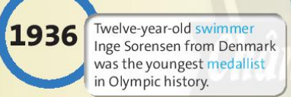
=> Swimming, marathon / running,
golf, rugby.

Slide 5
Activity 2:
False
(There were only silver and bronze medals.)
True
False
(She was from Denmark.)
True
False
(They were Olympic sports for the first time in 2016.)

Slide 6
1.winner (n)
/ˈwɪnə(r)/

Slide 7
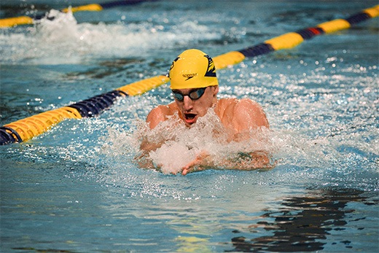
2. swimmer (n)
/ˈswɪmər/

Slide 8
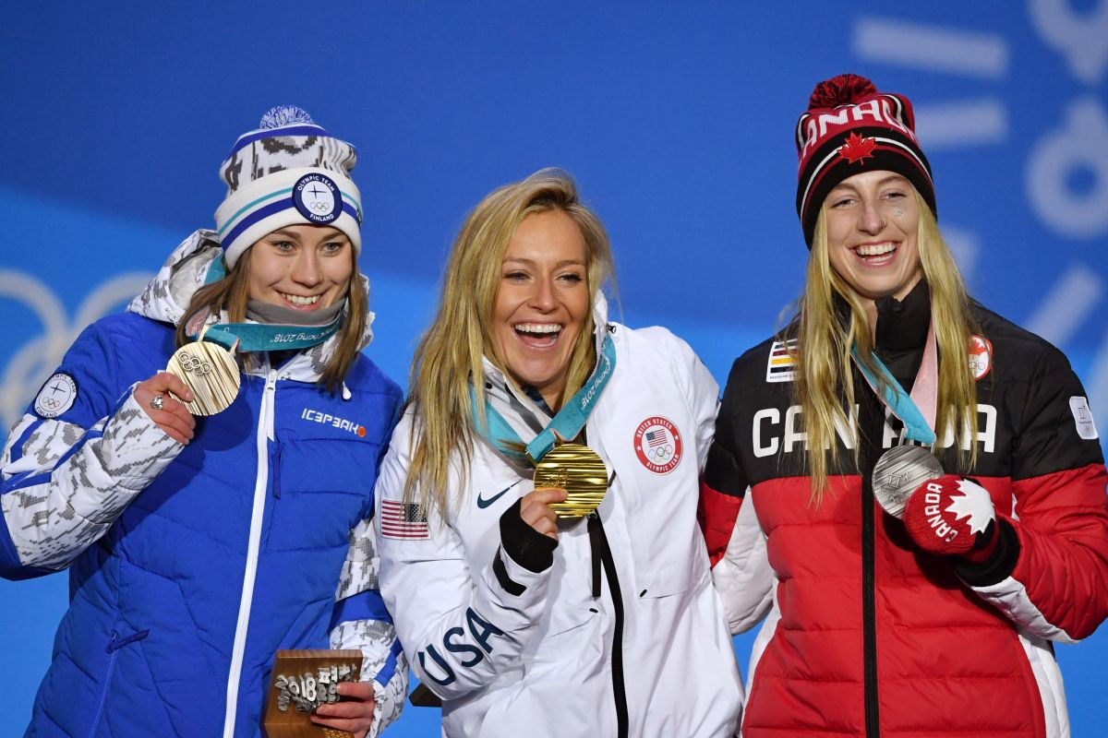
3. medallist (n)
/ˈmedəlɪst/

Slide 9
Complete the sentences with the blue words
from the text.
winner
1. A ______________ wins a competition.
2. A ______________wins a medal.
3. A ______________swims.
medallist
swimmer

Slide 10
Which piece of information in the text do you think is the most interesting?
What sports do you like watching in the Olympics?

Slide 11
HOMEWORK
Learn by heart all the new words.
Workbook: page 46.
Prepare Lesson 3 – LANGUAGE FOCUS.

Slide 12
Thank you!
CTCP ĐẦU TƯ VÀ PHÁT TRIỂN GIÁO DỤC PHƯƠNG NAM

